Slide 1

Pakistan Telecommunication Company Limited

Slide 2
Group Members
Tayyab Kamran (22I-2505)
Abdul Ahad Tariq (22L-7866)
Saad Tariq (22L-7912)
Imran Ahmed (22L-7983)

Slide 3
Table of contents
01
02
03
04
06
07
Introduction
Industry Review and Competitors
Evolution Of industry
Challenges
05
08
PRODUCTS/SERVICES/BRANDS BY PTCL
MARKETING DEPARTMENT/FUNCTION
Tackling
And Opinion
Problem Area
And best practices

Slide 4
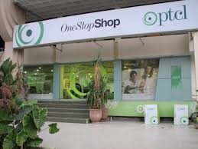
01
Introduction

Slide 5
History
Establishment in 1947
Evolution and Adaptation
Founded as a state-owned entity.
Emerged as the primary provider of landline telephony services in Pakistan.
Evolved alongside technological advancements.
Continuously adapted to meet changing market dynamics
Privatization in 2005
Government's decision to privatize PTCL.
Majority stake sold to Etisalat, marking a shift in ownership and operational dynamics

Slide 6
Key Operations
Extensive Network Infrastructure
Comprehensive Service Suite
Fiber optic cables, copper wires, and wireless technology facilitating seamless nationwide service delivery
Telecommunications and internet services tailored for consumers, businesses, and government institutions
Driving Digital Transformation
Playing a pivotal role in connecting people, businesses, and communities, fostering Pakistan's digital growth

Slide 7
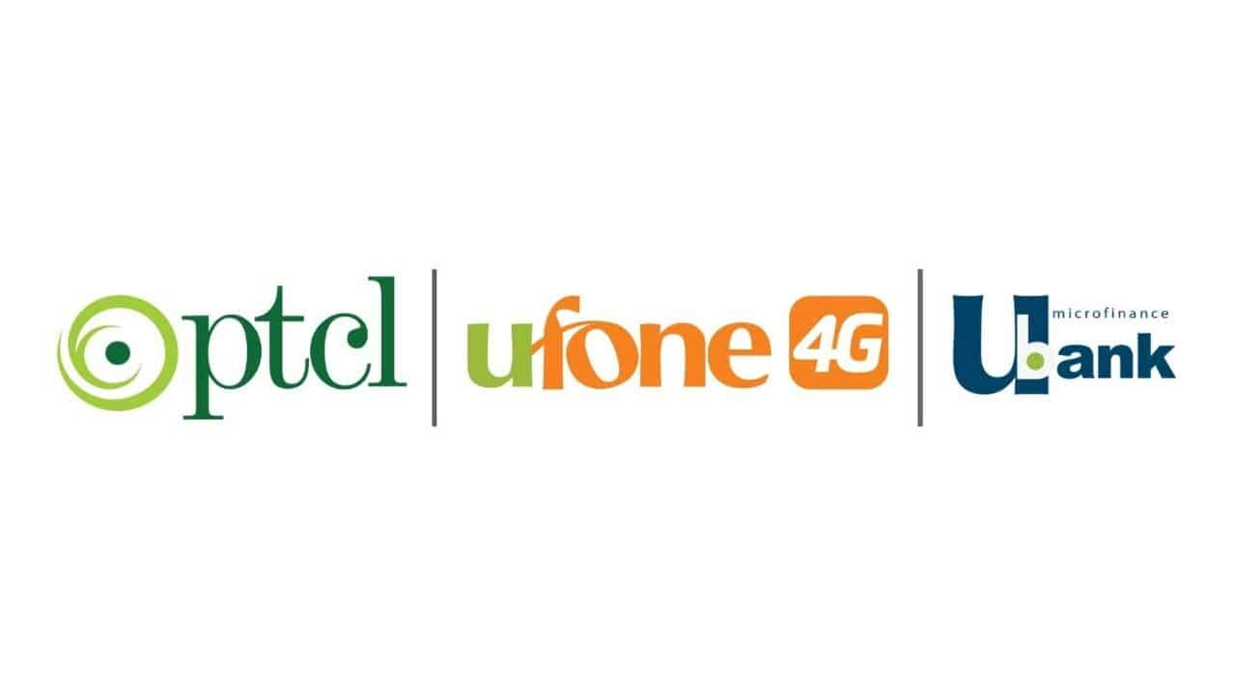
02
Industry Review and Competitors

Slide 8
Industry Reveiw:
Transition from traditional landline services to digital communication platforms.
Advancements in technology driving the evolution.
Competitors
Jazz (formerly Mobilink)
Telenor Pakistan
Zong

Slide 9
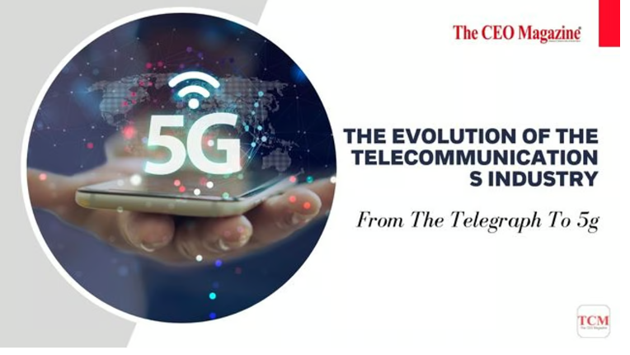
03
Evolution of Industry

Slide 10
Evolution of Industry
From Legacy to Landlines
Embracing New Technologies
Diversification and Competition
PTCL started in 1947 as the Posts & Telegraph Department.
In 1962, it transformed into the Pakistan Telephone and Telegraph Department, focusing on landline services.
PTCL became Pakistan Telecommunication Corporation (PTC) in 1991, adopting a more corporate structure.
PTCL entered the mobile phone market with Ufone in 2001, venturing beyond landlines.
The company launched PakNet for data services but later dissolved the brand, likely due to competition.
PTCL now directly manages DSL services, reflecting the growing importance of internet connectivity.

Slide 11
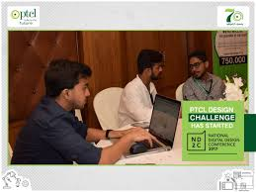
04
Challenges

Slide 12
Challenges
Regulatory Hurdles and Policy Inconsistencies
Infrastructure Limitations
Regulatory complexities affect investment decisions and market competition.
Inconsistent policies impact spectrum allocation and hinder industry growth, 5G Network.
High costs of deploying and maintaining network infrastructure hinder universal access.
Rural and underserved areas face challenges in accessing communication services.
Technological Advancement and Consumer Demands
Playing a pivotal role in connecting people, businesses, and communities, fostering Pakistan's digital growth, Fast Internet. People shifted to fibre networks.
Cybersecurity Threats
People avoiding the use of Internet due to privacy concerns. Users Data is not safe of customers in PTCL.

Slide 13

05
PRODUCTS/SERVICES/BRANDS BY PTCL

Slide 14
PRODUCTS/SERVICES/BRANDS BY PTCL
Landline Telephone
Broadband Internet
Digital Television
(PTCL Smart TV)
Enterprise Solutions

Slide 15
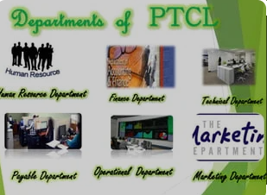
06
MARKETING DEPARTMENT/FUNCTION

Slide 16
MARKETING DEPARTMENT/FUNCTION:
Brand Management
Product Management
Digital Marketing
Sales and Distribution
Customer Relationship Management (CRM)

Slide 17

07
Problem Area And Background to problem

Slide 18
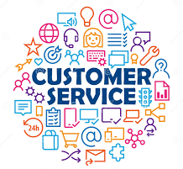
Problem Area
Despite competitive offerings, PTCL faces criticism for handling customer queries and complaints. This perception negatively impacts customer satisfaction, brand loyalty, and retention efforts

Slide 19
Background to the Problem
Scale and Complexity
Legacy Systems and Processes
Serving millions of customers across diverse regions poses challenges in maintaining consistent service quality.
Volume of inquiries and support requests strains resources, leading to delays in customer service.
State-owned monopoly roots leave PTCL with outdated systems and bureaucratic inefficiencies.
Complex support channels and delays hinder prompt issue resolution for customers
Technological Expectations
Customers expect seamless service experiences but PTCL's technological infrastructure may not meet these expectations.

Slide 20
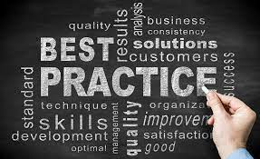
08
Best Practice in Customer Service

Slide 21

Best Practice in Customer Service
Proactive Communication
Prompt Issue Resolution
Personalized Interactions

Slide 22
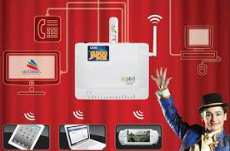
09
Tackling and Opinion

Slide 23
Tackling
Digital Self-Service Options
Investment in Frontline Staff Training
Allows customers to troubleshoot issues online independently.
Features FAQs, troubleshooting guides, and live chat support on PTCL's website and mobile app.
Focuses on soft skills like empathy and active listening to enhance customer interactions.
Empowers employees to better understand and address customer concerns.
Challenges in Implementation
Technical glitches and usability issues with digital self-service platforms.
Systemic issues such as resource constraints and inefficient processes hindering consistent service delivery

Slide 24
Opinion
Process Optimization
Investment in Technology
Culture of Continuous Improvement
Enhance customer interactions and response times through robust CRM systems, AI-powered chatbots, and omnichannel support platforms.
Identify and rectify bottlenecks and inefficiencies within internal processes to enhance operational efficiency and service delivery.
Value feedback from customers and employees, incentivize exceptional service through regular training, evaluations, and rewards
Transparency and Communication
Feedback Mechanisms
Build trust by proactively communicating service updates, outage notifications, and resolution timelines to manage customer expectations effectively
Actively seek customer feedback to understand needs and preferences, driving continuous innovation in service delivery

Slide 25

Conclusion
PTCL's longstanding presence and adaptability mark its significance in Pakistan's telecommunications landscape. Addressing challenges through technology investment, process optimization, and customer-centric initiatives can strengthen PTCL's market position and enhance customer satisfaction.

